Slide 1

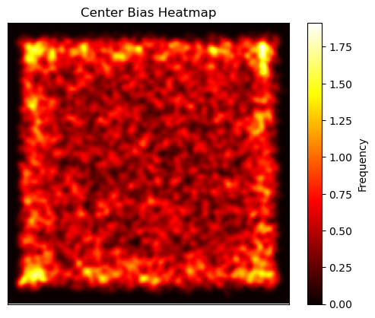
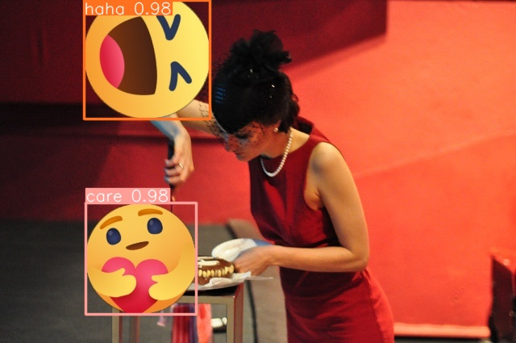
B.Sc. IT (Hons.)
Artificial Intelligence
Investigating the Impact of Inset Emojis on Images in News Articles
Isaac Muscat
Supervisor: Dylan Seychell
INTRODUCTION
Media plays a vital role in our society by keeping the public informed on events occurring around us. It is part of a media outlet’s responsibility to ensure an accurate and unbiased reporting when retelling news stories. However, some outlets nowadays tend to prioritise creating some form of sensationalism to generate more clicks than focus on delivering quality journalism to the public [1]. Recent studies [2, 3] highlight the effects images may have on a reader’s overall perception of a news article, emphasising the need for an ethical use of visual narration. This research aims to explore the impact of inset emojis within news articles and developing methods to be able to detect such bias and mitigate it as much as possible. The study highlights the need for collaboration between the field of computer science, social science, and the media to improve automated bias detection and uphold journalistic integrity in the digital age.
EXAMPLE IMAGES & RESULTS
Dataset Centre Bias Heatmap
AIM
The main aim of this research was to investigate the potential change in opinion a person may have when an emoji is placed onto an image compared to the image without it. To perform such a task, a survey was made to check how such a change in opinion occurs, and if there are any correlations to note. Furthermore, an interview was also conducted with a professional in the media industry to gain any further insights about the use of emojis in news articles. Once the hypothesis was proven to be true, a dataset of inset emojis was created on which object detection models were trained to be able to locate inset emojis within images.
YOLOv8 Emojis Detected
METHODOLOGY
Create Inset Emoji Dataset using COCO dataset and Facebook Emojis
Create Survey to evaluate the influence inset emojis have on opinion.
Conduct interview with media professional to gather additional insights.
Train Object Detection models using created dataset – YOLOv8 and RetinaNet models
RESULTS
The research was evaluated in terms of three sections: the quality of the dataset generated, the performance of the object detection models trained as well as the analysis of the human evaluation section of the project, this being the survey and the interview. With respect to the dataset generated, a centre bias graph was generated to depict the positions of the centre coordinates of each emoji inset, which showed that the dataset’s emojis are evenly distributed across the dataset. Furthermore, an emoji frequency graph showed an even distribution, with the "Wow" emoji being most frequent and "Haha" least. Also, size distribution graphs indicated most emojis occupied about 3.5% of the image area. With respect to the object detection models trained, these being YOLOv8 and RetinaNet, the former model exhibited an overall better performance in the graphs generated, these being the Recall, Precision, Precision-Recall, and F1 curves. The survey, completed by 170 respondents, revealed that while images are generally important in news articles, most participants found inset emojis to detract from the articles' credibility and did not enhance understanding or engagement. The impact of emojis on opinion varied, with "Angry" emojis notably causing the sharpest change in opinion, while "Like" and "Heart" emojis had minimal effect. The survey also indicated that excessive emojis could frustrate readers. In the interview, the media professional criticised the use of emojis in news articles for trivialising and potentially manipulating content, emphasising the importance of high-quality images and storytelling to maintain journalistic integrity and neutrality.
CONCLUSIONS AND FUTURE WORK
The project confirmed that inset emojis influence news article readers, although the results of this were gathered from a small Maltese sample, which may this limit the study’s generalisability. However, given the global use of Facebook emojis, similar findings are expected internationally. The dataset and object detection models developed can serve as an important resource to address media bias issues, showing promising precision despite needing further research. Future improvements could include expanding the dataset with other emoji types, training new object detection models as AI advances, and incorporating qualitative human evaluations and more interviews to deepen insights.
REFERENCES
S. Mullainathan and A. Shleifer, “Media bias,” National Bureau of Economic Research, 1050 Massachusetts Avenue, Cambridge, MA 02138, Working Paper 9295, Oct. 2002. H.‐W. Hu, Y.‐K. Tsay, and C.‐Y. Peng, “Influence of online news features on user behavior for new media,” in 2018 IEEE International Conference on Big Data (Big Data), 2018, pp. 3659–3664. doi: 10.1109/BigData.2018.8621963. S. L. Sargent, “Image effects on selective exposure to computer‐mediated news stories,” Computers in Human Behavior, vol. 23, no. 1, pp. 705–726, Jan. 2007. doi: 10.1016/j.chb.2004.11.005.

